Slide 1
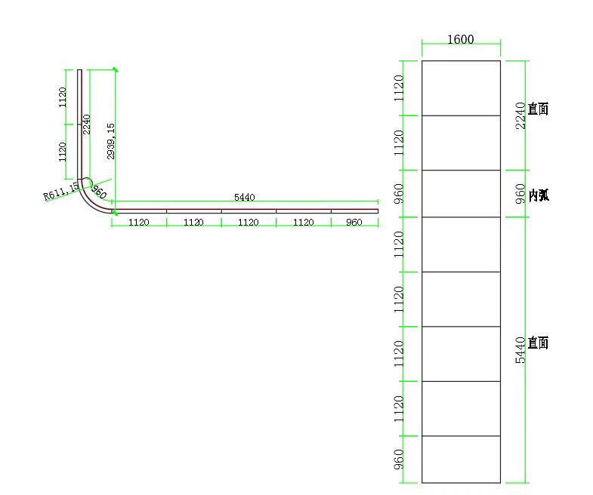
Upright
Curved
Resolution listed in source: 800 × 4320 pixels
Upright 1120 + Curved 480 + Floor 2720
(Upright + curved) : floor = approx. 35% : 65%
Floor
Codec: H.264
File format: MP4
Bitrate: approximately 8–12 Mbps
Frame rate: 30 fps
Source ratio is approximate; pixel totals imply about 37% : 63%.
Confirm final canvas orientation and playback mapping before export.

Slide 2
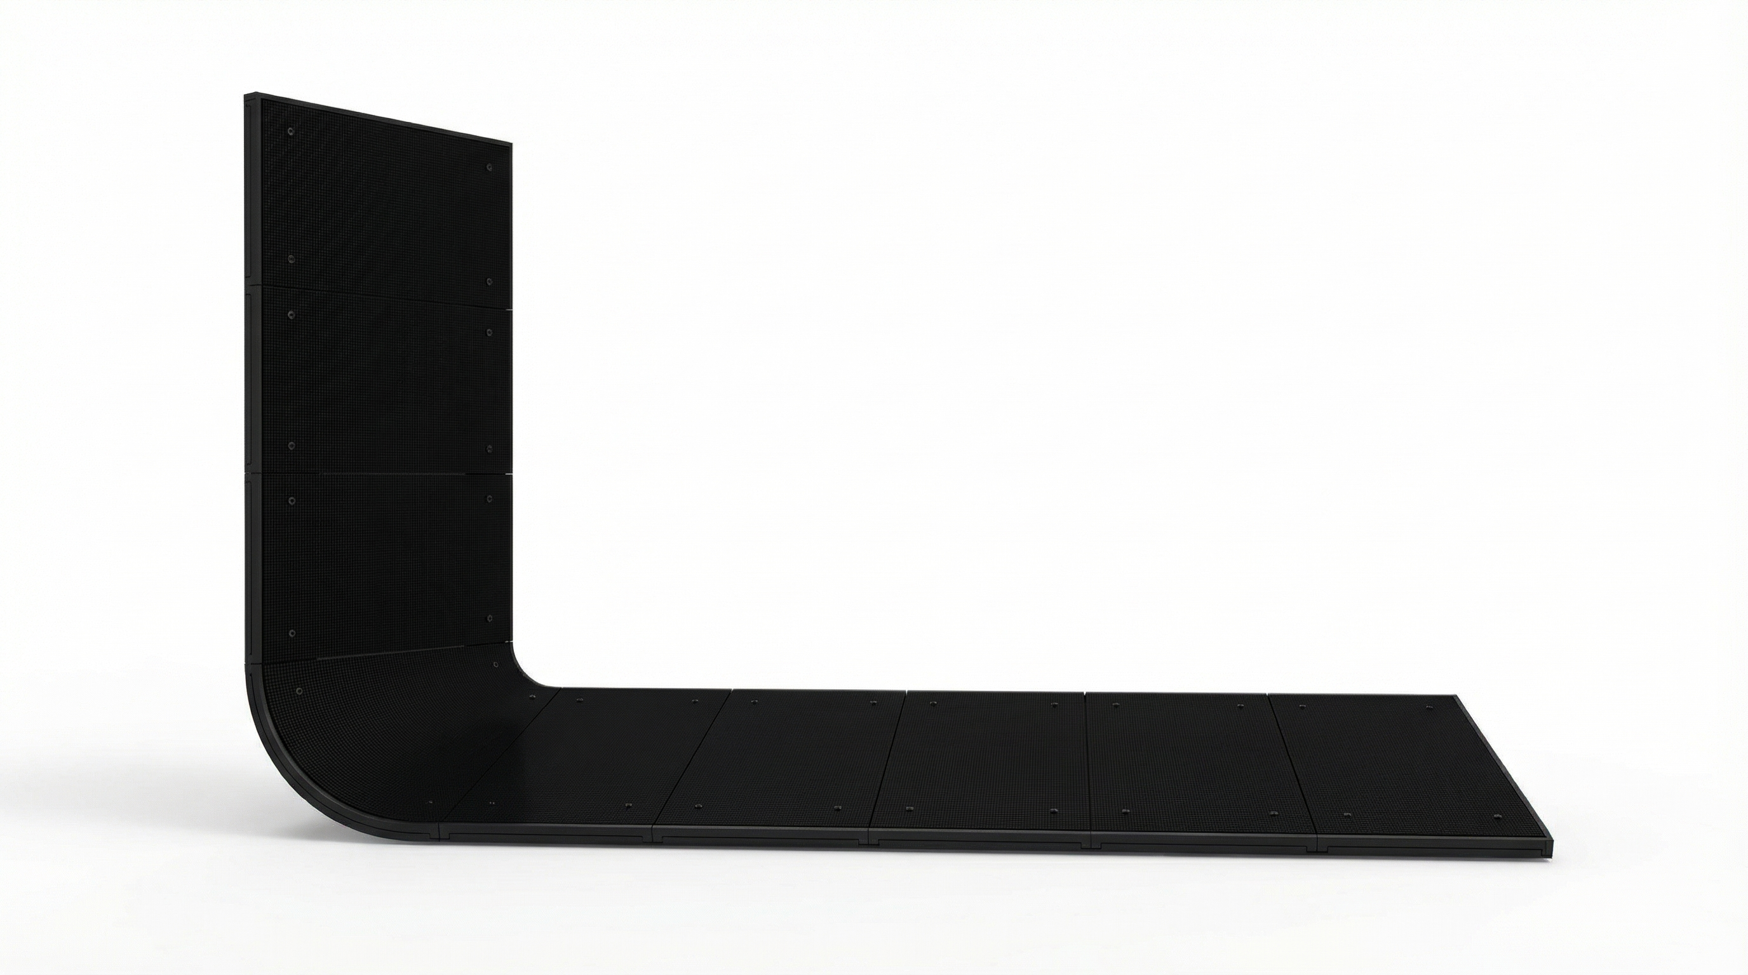
Width 614cm x Height 294cm x Depth 160cm x Thickness10 cm

Slide 3
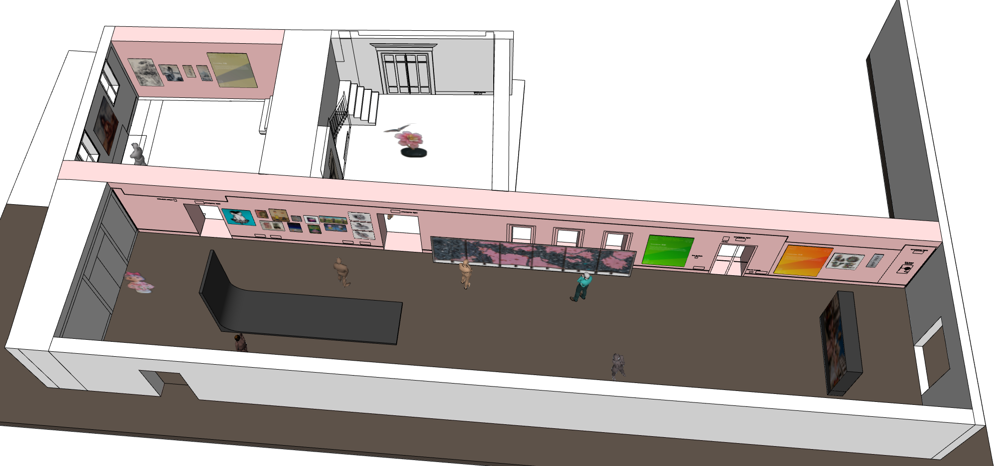

Slide 4
